Slide 1
Sign Language Recognition
Deep Neural Network
Myrto Potamiti, Panagiotis Korovesis, Giannis Fourfouris

Slide 2
Contents
Overview
Datasets
Custom Neural and Convolutional Networks
Transfer Learning
Vision Transformers
Best Models Comparison
Conclusion & Future Work
Notes:
We’ll start with an overview of our objectives and methodology.
Next, we’ll explore the datasets, highlighting their diversity and complexity.
Then, we’ll dive into the custom neural and convolutional networks, focusing on their architectures and performance.
We’ll discuss transfer learning and how pre-trained models improve accuracy and efficiency.
We’ll also examine vision transformers and their ability to handle complex datasets.
A model comparison follows, identifying the top performer.
Finally, we’ll wrap up with our conclusion and future work.

Slide 3
Overview
Project Goal:
Develop an effective system for recognizing hand gestures in sign language.
Methodology:
Begin with baseline models to establish performance metrics.
Progress to more complex models for challenging datasets.
Apply techniques like fine-tuning and transfer learning.
Datasets:
Examination of six different sign language datasets.
Key Observations:
Comparison of model architectures and effectiveness.
Experimental insights on performance across datasets.
Notes:
The goal of this project is to develop an effective system for recognizing hand gestures in sign language. To achieve this, we begin with baseline models to establish performance benchmarks. Then, we progress to more complex models capable of handling challenging datasets. Techniques such as fine-tuning and transfer learning are applied to further improve accuracy and generalization.
Our study evaluates six diverse sign language datasets, each with different levels of complexity. Finally, we analyze key observations from our experiments. We compare different model architectures and assess their effectiveness, identifying the most promising approach for sign language recognition.

Slide 4
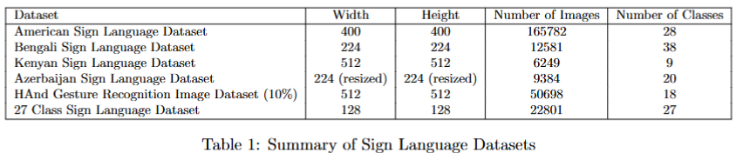
Datasets (1/2)
Variety of Datasets:
Analysis of six distinct sign language datasets, each representing different alphabets and gestures.
Notes:
This study utilizes six distinct sign language datasets, each representing different alphabets, gestures and complexities. These include American Sign Language (ASL), Bengali Sign Language, Kenyan Sign Language, Azerbaijani Sign Language, the Hand Gesture Recognition Image dataset, and a 27-Class Sign Language dataset. Each dataset introduces unique challenges, such as variations in backgrounds, hand positions and individual performers. These differences help evaluate model robustness and adaptability across diverse real-world scenarios.

Slide 5
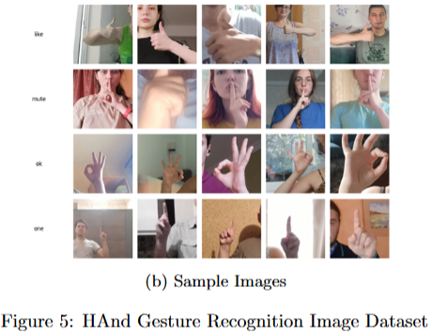
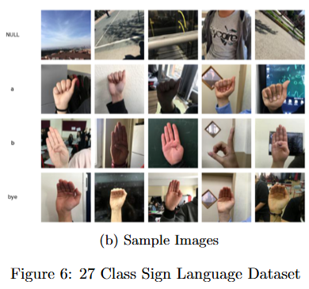
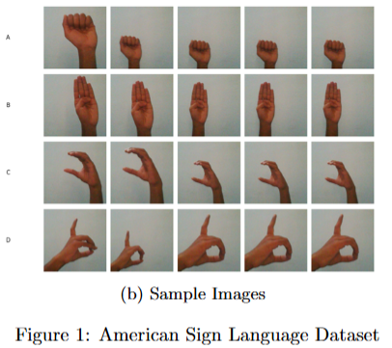
Datasets (2/2)
Notes:
The datasets were carefully selected to follow a progressive difficulty gradient, ensuring a thorough evaluation of model performance across different levels of complexity.
We started with simpler, well-structured datasets like American Sign Language (ASL), which provided a strong baseline for training and validation.
As the study progressed, we introduced more challenging datasets, such as the 27-Class Sign Language Dataset, which included greater variability in backgrounds and hand positions. Finally, we incorporated challenging datasets, such as the Hand Gesture Recognition Image dataset, designed to test the models’ ability to handle a diversity of backgrounds, different angles, positions and colors. This step-by-step approach allowed us to identify model strengths and weaknesses, particularly regarding generalization and overfitting, and guided improvements for handling increasingly complex real-world scenarios.

Slide 6
Custom Neural and Convolutional Networks – Models Architecture (1/2)
Model Development:
Three distinct neural network models were developed from scratch to establish a performance baseline.
Simple Feedforward Neural Network
Fully connected architecture with a flatten layer.
Linear layer (500 hidden units) with ReLU activation.
Simple Convolutional Neural Network (CNN)
Two convolutional layers for feature extraction.
Layer 1: 32 filters (5×5) with ReLU.
Layer 2: 16 filters (3×3) with ReLU.
Flatten layer for classification.
Notes:
In the Model Development phase, three distinct neural network models were developed from scratch to establish a performance baseline. The first model, a Simple Feedforward Neural Network, features a fully connected architecture with a flatten layer, followed by a linear layer containing 500 hidden units and ReLU activation. The second model, a Simple Convolutional Neural Network (CNN), incorporates two convolutional layers for feature extraction: the first layer uses 32 filters (5×5) with ReLU activation, and the second layer uses 16 filters (3×3) with ReLU activation, followed by a flatten layer for classification.

Slide 7
Custom Neural and Convolutional Networks - Models Architecture (2/2)
Enhanced Convolutional Neural Network (CNN)
Conv Layer 1: 32 filters (5×5), ReLU, Batch Norm.
Max-Pool 1: 2×2 kernel for down-sampling.
Conv Layer 2: 16 filters (3×3), ReLU, Batch Norm.
Max-Pool 2: 2×2 kernel for further down-sampling.
Dropout Layer: Reduces overfitting (rate: 0.5).
Fully Connected Layer: Processes features into predictions.
Early Stopping: Prevents overfitting by monitoring validation performance.
All models were optimized using Stochastic Gradient Descent (SGD) with a learning rate of 0.001 and Nesterov momentum (0.9).
Supervised learning with mini-batch SGD and cross-entropy loss.
Validation sets used to track performance and prevent overfitting (70% train, 20% validation, 10% test).
Notes:
The Enhanced Convolutional Neural Network (CNN) improves on a standard CNN by adding layers to address overfitting and enhance generalization. It starts with Conv Layer 1 (32 filters, 5×5) with ReLU and Batch Normalization, followed by Max-Pool 1 (2×2). Conv Layer 2 (16 filters, 3×3) refines features, and Max-Pool 2 further reduces dimensionality. A Dropout Layer (0.5 rate) helps prevent overfitting, and a Fully Connected Layer generates predictions. Early Stopping halts training when overfitting is detected. In all models, Optimization was done using Stochastic Gradient Descent (SGD) with a learning rate of 0.001 and Nesterov momentum (0.9). The datasets were split into 70% training, 20% validation, and 10% testing, with the validation set helping to monitor overfitting.

Slide 8
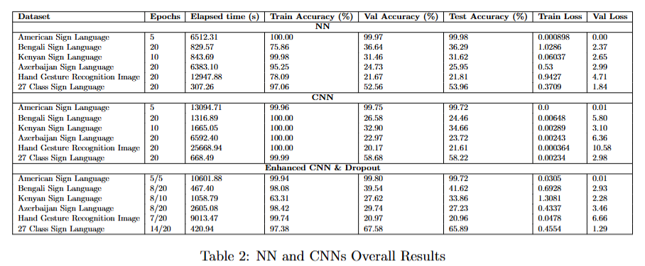
Custom Neural and Convolutional Networks – Results (1/4)
Notes:
This table summarizes the performance of the different neural network models across the various datasets. We record values such as the number of epochs, training, validation and test accuracy, as well as training and validation loss, which we discuss in the next slides.

Slide 9
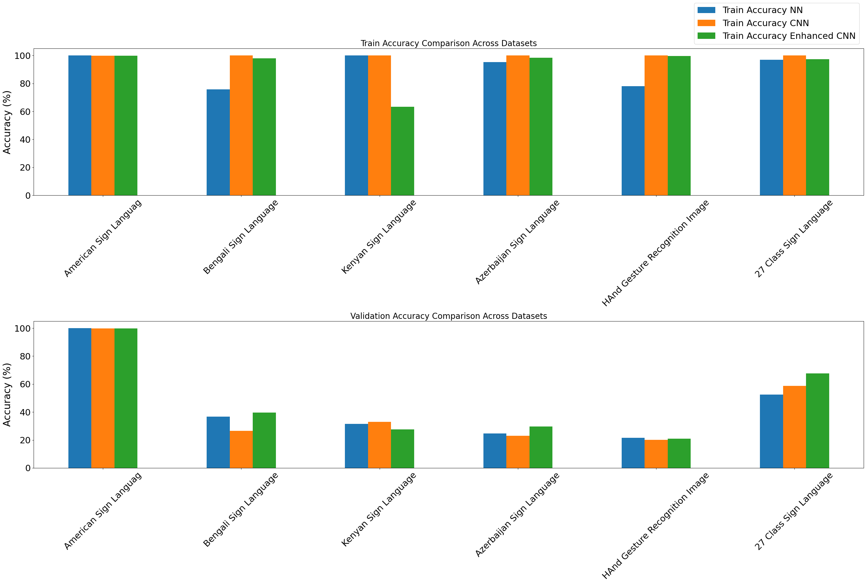
Custom Neural and Convolutional Networks – Results (2/4)
Notes:
This plot shows the accuracy for the different datasets and models on the training and validation sets. The test set was excluded for sizing reasons, as it behaves similarly to the validation set. The results show that while NN models achieve high training accuracy, they struggle with generalization on validation and test sets, especially for more complex datasets like Bengali and Kenyan Sign Language. In contrast, CNN models generally demonstrate better performance, with higher accuracy and lower loss, particularly in training. The Enhanced CNN with Dropout model shows a mix of results, with improvements in some datasets but challenges in others, indicating that while dropout can aid generalization, further optimization may be needed.

Slide 10
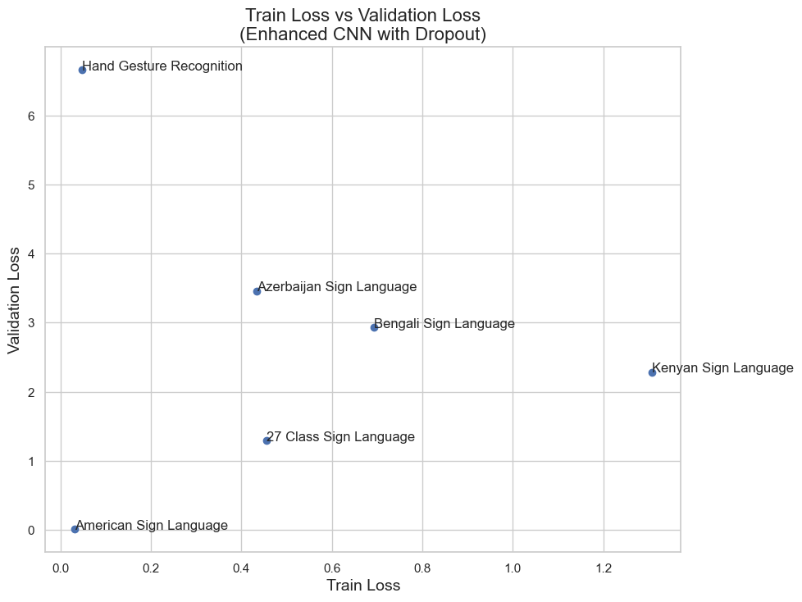
Custom Neural and Convolutional Networks – Results (3/4)
Low Training Loss, High Validation Loss:
Indicates overfitting.
High Training and Validation Loss:
Suggests difficulty in learning from the training data (underfitting).
Notes:
When analyzing the relationship between training and validation loss, a low training loss paired with a high validation loss often indicates overfitting. This occurs when the model fits the training data very well but fails to generalize effectively to unseen data. On the other hand, when both training and validation losses are high, it suggests underfitting. In this case, the model struggles to learn even the basic patterns from the training data, indicating that it may not be complex enough or is not being trained long enough. Both scenarios highlight the need for proper model tuning and regularization to ensure the model strikes a balance between fitting the data well and generalizing effectively.

Slide 11
Custom Neural and Convolutional Networks – Results (4/4)
Training Time Implication:
Trade-off between model complexity, dataset size and optimization.
Dataset-Specific Insights:
Larger, complex datasets resulted in lower accuracies.
Enhanced CNN + Dropout reduced overfitting, improving generalization.
Training Dynamics:
Early stopping optimized performance, preventing excessive training.
Conclusion:
Architectural tuning & regularization are key for complex sign language datasets.
No single model fits all the datasets.
Notes:
Training time implications highlight the trade-off between model complexity, dataset size, and optimization efficiency. Larger, more complex datasets, such as Bengali Sign Language and HaGRID, require more resources and time, but often result in lower accuracies due to challenges in generalization. The Enhanced CNN with Dropout showed significant improvements by reducing overfitting and enhancing generalization, even on complex datasets. Optimizing training dynamics with early stopping further improved efficiency by halting training when validation performance plateaued. Architectural tuning and regularization are crucial for complex sign language datasets, and the key takeaway is that no single model fits all datasets.

Slide 12
Transfer Learning (1/3): Overview
Definition: Using a pre-trained model and fine-tuning it on our specific dataset or task
Two main ways to train these models:
Create a new classification head and train in
Create a new classification head and train the entire model
We used two established models, both trained on ImageNet:
MobileNetV2
ConvNetXtBase
Notes:
Now let’s look at the second approach: Transfer Learning.
Our goal is to leverage pre-trained models to achieve better performance that the previous models.
Two approaches are explored in our research:
The first is to import pre-trained models and replace their classification head with a new one that fits our data and train only this CLH
The second is to fine tune the entire model
We chose two established models, both trained on the ImageNet Dataset:
MobileNetV2
ConvNetXtBase

Slide 13
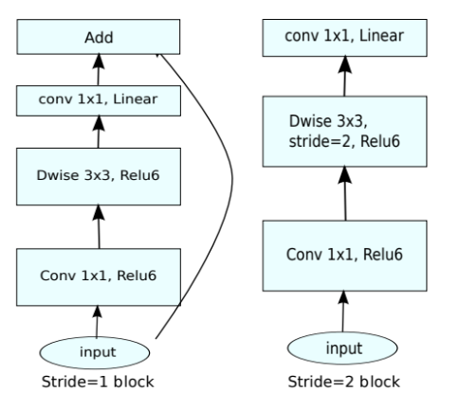
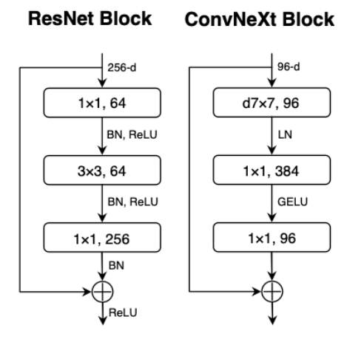
Transfer Learning (2/3): Model Architecture
MobileNetV2 Architecture
ConvNetXtBase Architecture
Notes:
MobileNetV2
Architecture Overview: MobileNetV2 consists of two types of blocks: residual blocks with a stride of 1 and downsizing blocks with a stride of 2, featuring a total of three layers for each block type.
Convolutional Layers: The model employs a combination of point-wise and depth-wise convolutions, with the first layer creating new features, the second applying a single filter per input channel, and the last layer being a point-wise convolution without non-linearity.
Activation Function: To address the exploding gradients issue, MobileNetV2 utilizes the ReLU6 activation function, enhancing stability during training.
ConvNetXt
Model Improvements: ConvNetXt is based on the ResNet50 architecture but incorporates significant enhancements, such as replacing the ReLU activation function with GeLU and using the AdamW optimizer.
Block Structure: It has a reverse bottleneck structure, which was made popular by MobileNet. (ie the input dim is exploded inside the block and then converted back to the initial to allow the residual connection)
We have a depth wise convolution with a 7x7 kernel, then a pointwise which explodes the dim by 4 times 4*96 = 384 and finally a pointwise which convets it back to the original size.
Stem Layer Modifications: In the stem layer, ConvNetXt replaces traditional convolution kernels with non-overlapping 4x4 kernels, improving the model's efficiency and effectiveness.

Slide 14
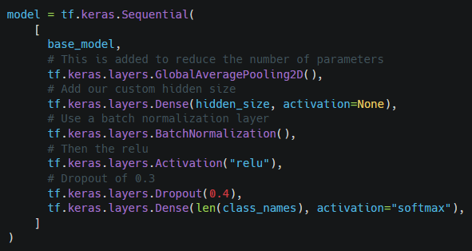
Transfer Learning (3/3): Classification Head
We used the same classification head for all experiments, treating the hidden size as a hyper parameter.
Adam Optimizer was used for all experiments:
LR: 0.001 for CLH only
LR: 0.0001 for the entire model
Early Stopping was used to prevent overfit
Notes:
Finally let’s look at the classification head.
We used the same classification head for all experiments, treating the hidden size as a hyper parameter. The sizes tested were 128, 256, 512
We added GlobalAveragePooling to reduce the number of trainable parameters and Batch Normalization to “iron out” any abnormalities
Relu was the activation function
We went with a high dropout of 0.4 and with Early Stopping to prevent any overfit.

Slide 15
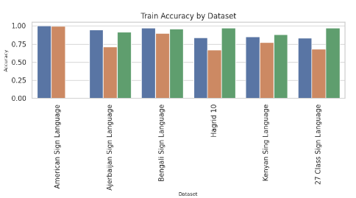
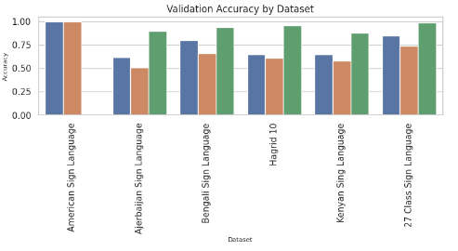
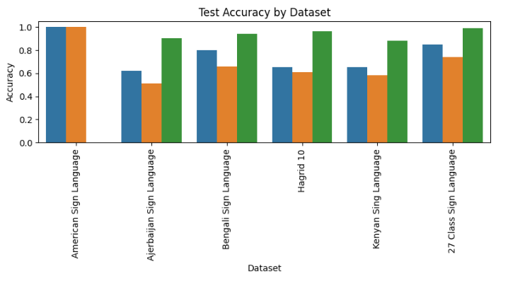

Transfer Learning Results (1/3)
MobileNetV2 outperformed ConvNetXtBase in for experiments
Fine-tunning the entire model resulted in significant improvements for all experiments
The train and validation scores are similar which suggest a proper training without overfitting.
* A detailed performance report can be found at Table 3 in the technical report
Notes:
Let’s take a look at the results:
The first observation we can make is that MobileNetV2, although smaller outperformed ConvNetXt in all datasets.
Also, as expected fine tuning the entire model resulted in significant improvements both in the train and validation accuracy
The train and validation scores are similar, with the validation scores being lower of course, which suggests a proper training without overfitting.

Slide 16
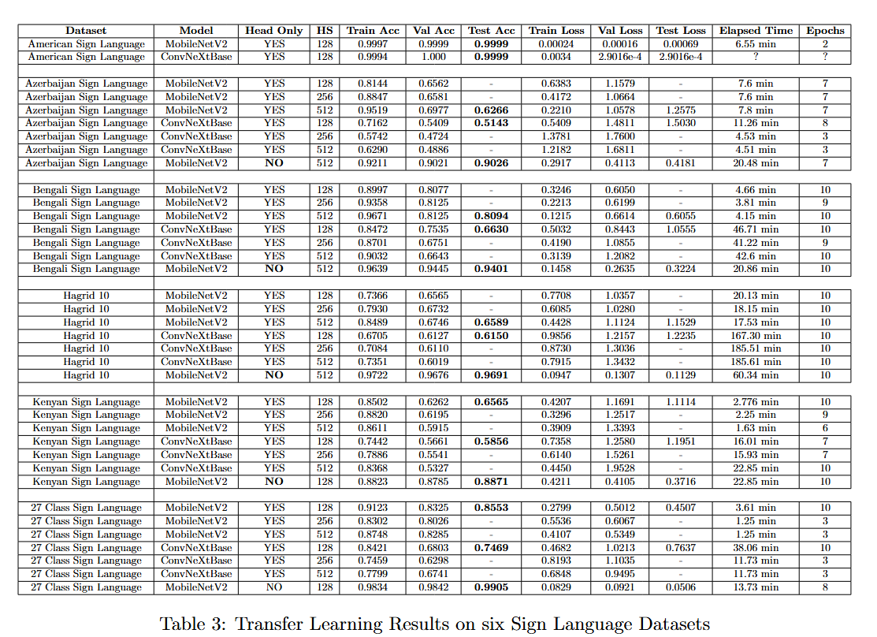
Transfer Learning Results (2/3)
Notes:
And this is the table with all the experiments.
I want say everything don’t worry
I want to point out some specific cases
Starting from the top, it’s clear that that the ASL dataset wasn’t challenging, leading to 100% accuracy
Fine tunning the entire model resulted gave excellent results on the Azerbaijan Sign Language Dataset, raising the bar from 62 to 90% test accuracy
Same thing for the Hand Gesture Recognition Dataset were we went from 0.65 to 96% test accuracy.

Slide 17
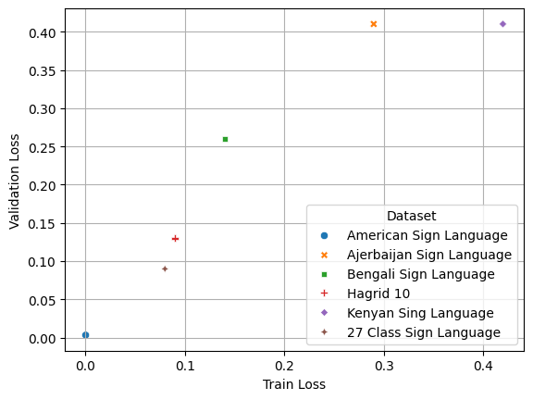
Transfer Learning Results (3/3)
This graph shows the train and validation loss of the best model for each dataset
Elements along the diagonal have similar train and validation loss
Four out of six points have almost identical train and validation loss
The larger difference is ~ 0.1 for the Hand Gesture Recognition Dataset
Transfer Learning: Overall
Transfer Learning closed the gap that traditional architectures left
While training only the classification head is a good initial approach, the benefits from training the entire model, definitely outweigh the training overhead
Notes:
Finally, lets take a look at the following scatter plot.
It shows the difference between the train and the validation loss for the best model for each dataset.
A quick reminder from before, low train / high val loss indicates overfit, whereas high train and val loss indicates incapability to learn the data patterns.
Almost all datasets are on the diagonal. They have the same train and val loss
The only notable exception is the Hand Gesture Recognition Dataset (Hagrid) which still only has a difference of about ~ 0.1

Slide 18
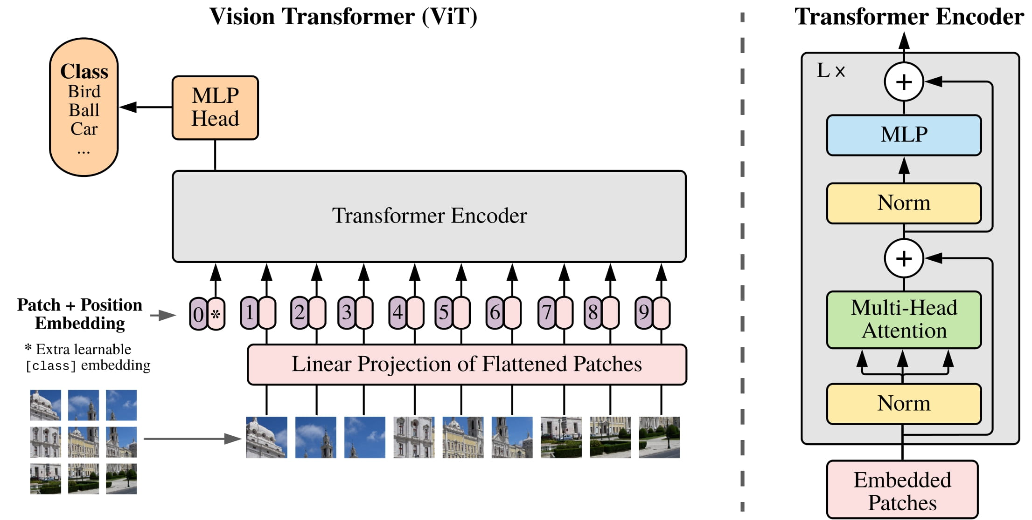
Vision Transformers (1/2): Overview
Transformer architecture for image processing: images a sequences
Pre-trained on large datasets
Self-attention mechanism: local and global dependencies
CLS token for classification
Notes:
Vision Transformers, or ViTs, are a type of model for image processing that treats images as sequences of patches, much like how words are treated in text processing. These models are often pre-trained on large datasets like ImageNet to improve their generalization. The core advantage of Vision Transformers lies in their self-attention mechanism, which allows the model to capture both local and global dependencies within the image. Unlike CNNs, which primarily focus on local features. For classification, a special [CLS token] is added to the sequence of image patches. This token aggregates the information from all patches, and its final representation is used to predict the image class.

Slide 19
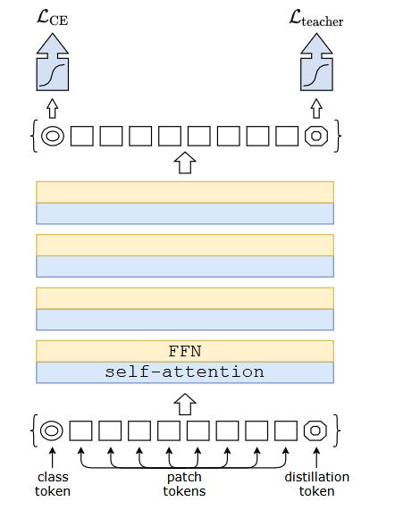
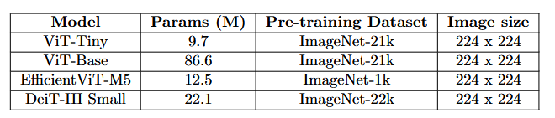
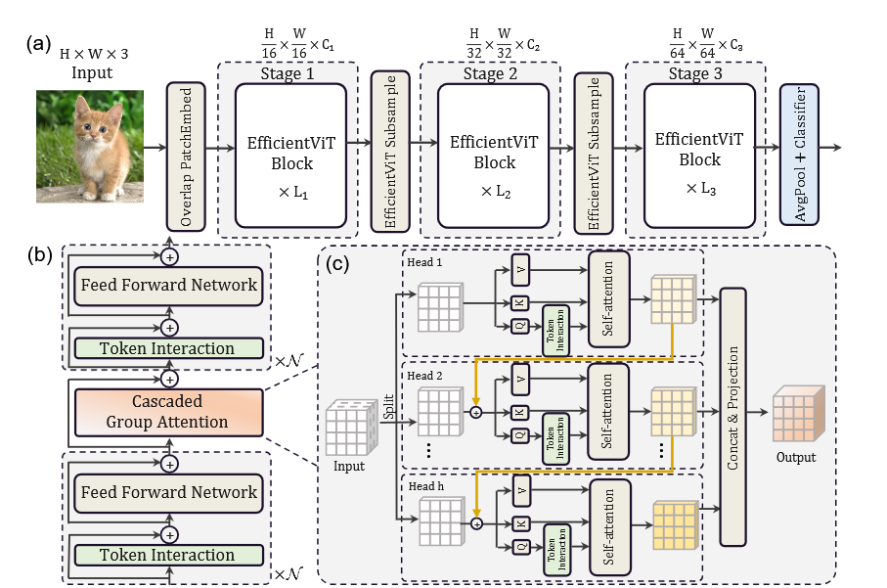
Vision Transformer(2/2): Architectures
Vision transformer variants:
Data-efficient Image Transformer (DeiT-III)
Distillation token for knowledge transfer from teacher model (CNN)
Efficient Vision Transformer (EfficientViT-M5)
Memory efficiency with Cascaded Group Attention
Notes:
In our experiments, we tested both classic Vision Transformer (ViT) architectures as well as two variants, each with distinct characteristics.
First, we used ViT-Tiny, which has 9.7 million parameters and is pre-trained on ImageNet-21k. We tested two approaches for fine-tuning: training the entire model and training only the classifier head.
Next, we tested ViT-Base, a larger model with 86.6 million parameters, also pre-trained on ImageNet-21k. Due to the size of this model, we only fine-tuned the classifier head.
The first variant we explored is the Efficient Vision Transformer (EfficientViT-M5), which contains 12.5 million parameters and is pre-trained on ImageNet-1k. We fine-tuned the entire model. This architecture employs a Cascaded Group Attention mechanism, which provides memory efficiency without compromising performance, making it a suitable option for scenarios with limited computational resources.
The second variant is the Data-efficient Image Transformer (DeiT-III Small), with 22.1 million parameters and pre-trained on ImageNet-22k. DeiT models use a distillation token for knowledge transfer from a teacher model, usually a convolutional neural network (CNN), which helps reduce the need for large datasets.
All models in this experiment were trained on images with a resolution of 224x224

Slide 20
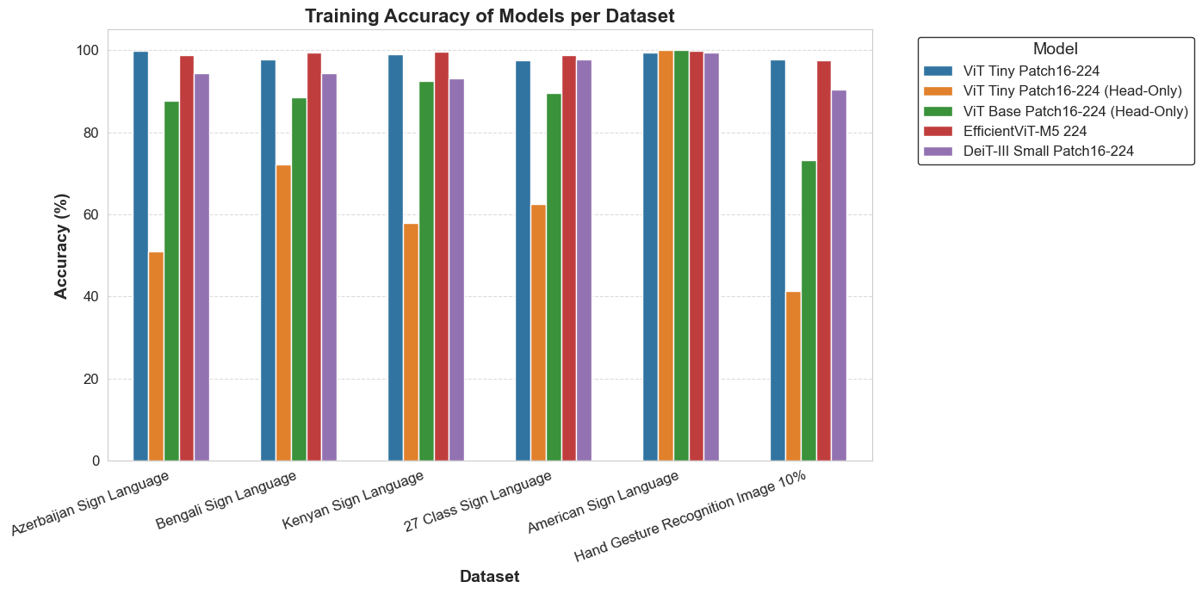
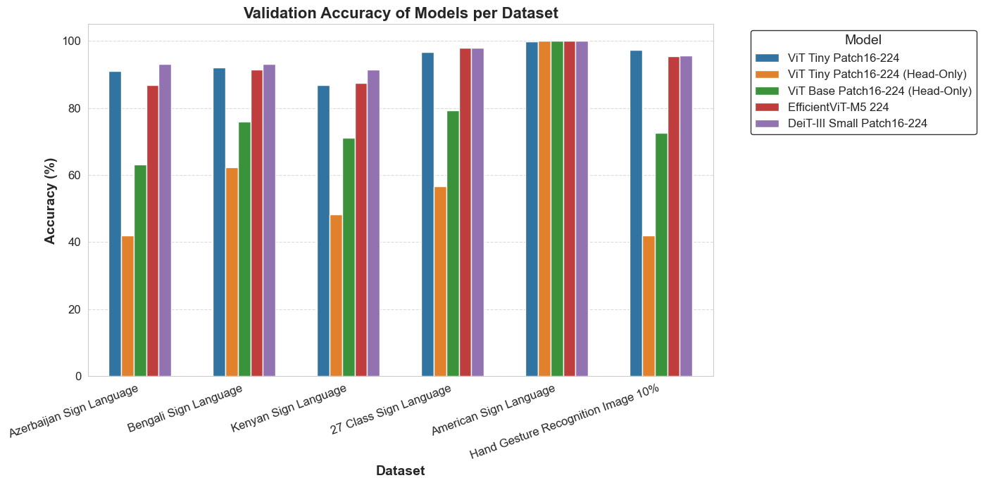
Vision Transformers(1/3): Results
Visual Transformer Variants: High performance across all datasets
Classification head training: Overfitting on more complex datasets
Simpler datasets: Strong generalization
Notes:
Now we will evaluate the models performance. On this plot on the left we see the training accuracy and on the right the validation accuracy. We observe that on simpler datasets like the American sign language all models perform almost perfect indicating strong generalization. The models were we trained only the classification head tend to perform poorly. To elaborate on more complec datasets like the Bengali dataset for the Vit-Tiny where we trained the classification head and the ViT base th training accuracy is higher than the validation accuracy. Also the visual transformer variants efficient vit noted with red and DeiT with purple in many datasets outperform the classic variants and produce high accuracy on most of them.

Slide 21
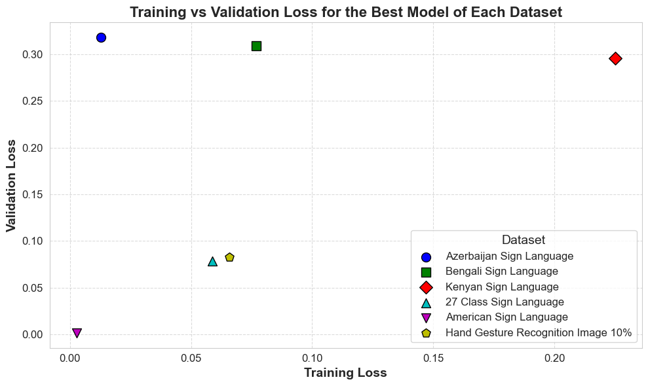
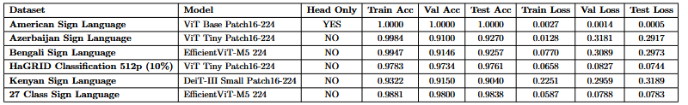
Vision Transformers(2/3): Results
Overfitting: ViT Tiny for Azerbaijan & Bengali Sign Language
Underfitting: DeiT-III Small for Kenyan Sign Language
Test accuracy achieved higher than 90%
Notes:
Although we achieve high test accuracy (above 90%) with the best models for each dataset, notable differences in training and validation losses suggest areas for improvement. Datasets like Azerbaijan and Bengali Sign Language show a gap between low training loss and higher validation loss, indicating overfitting. In contrast, datasets like 27 Class Sign Language and American Sign Language demonstrate good generalization with low, similar losses. However, the Kenyan Sign Language dataset shows higher training loss and accuracy, suggesting underfitting.

Slide 22
Vision Transformers(3/3): Results
Effect of head-only fine-tuning:
More epochs and computational cost.
Lower accuracy on more complex datasets
Overfitting on complex datasets
Architecture with optimal time-accuracy tradeoff: EfficientViT-M5
Scalable computation times
High accuracy across all datasets
Vision transformers data hungry nature: Weaker performance on small datasets
Notes:
To conclude, the experiments revealed some key insights into Vision Transformer performance. We observed that head-only fine-tuning often leads to lower accuracy, especially on more complex datasets, while also increasing the number of required epochs and computational cost. It is worth to highlight also that EfficientViT-M5 proved to be the optimal model, offering a strong balance between time and accuracy, achieving high performance across all datasets tested, while maintaining scalable computation times. However, one challenge that persists with Vision Transformers is their data-hungry nature. As expected, their performance tends to drop on smaller datasets, like the Kenyan sign language, and the models required more epochs to converege.

Slide 23
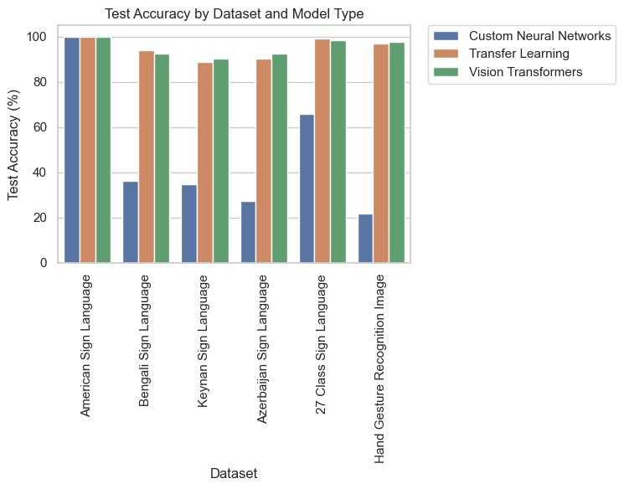
Best Models Comparison
Key Takeaways:
Traditional neural networks struggled to generalize.
Transfer Learning & Fine-Tuned Vision Transformers consistently achieved superior results.
Pre-trained features significantly improved accuracy across all datasets.
Notes:
We compared the top-performing models across different training approaches—Custom Neural Networks, Transfer Learning, and Vision Transformers—based on their performance metrics for each dataset. At a glance, the key takeaways are clear: traditional neural networks struggled to generalize, while Transfer Learning and Fine-Tuned Vision Transformers consistently delivered superior results. The use of pre-trained features significantly improved accuracy across all datasets, highlighting the advantages of leveraging existing knowledge for better model performance.

Slide 24
Conclusion & Future Work
Evaluated Custom Neural Networks, Transfer Learning and Vision Transformers on multiple sign language datasets.
Key Insights:
Model selection depends on dataset characteristics and application needs.
Transfer Learning & Fine-Tuning require less effort than training models from scratch and achieve better accuracy with limited data.
Future Work:
Advanced Data Augmentation.
Leverage Video Datasets.
Real-Time Processing.
Notes:
We evaluated Custom Neural Networks, Transfer Learning, and Vision Transformers across multiple sign language datasets to understand their performance. The key insights from our analysis show that model selection should be guided by dataset characteristics and application needs. Notably, Transfer Learning and Fine-Tuning require significantly less effort than training models from scratch while achieving better accuracy, especially with limited data. Looking ahead, our future work will focus on enhancing model robustness through advanced data augmentation, leveraging video datasets to capture temporal dynamics and utilize models for real-time processing on edge devices.

